Slide 1
Logging in Python

Slide 2
Introduction
Python provides a very powerful logging library in its standard library.
A lot of programmers use print statements for debugging
You can also use logging to do this.
It’s actually cleaner to use logging as
One won’t have to go through all your code to remove the print statements.
It also provides much more extra features which we will look at now.

Slide 3
Why Use the logging Module
It keeps a record of the events that occur within a program
It becomes difficult to distinguish between debugging output and normal program output because the two are mixed
When using print() statements dispersed throughout code, there is no easy way to disable the ones that provide debugging output
It becomes difficult to remove all the print() statements when you are done with debugging
There is no log record that contains readily available diagnostic information

Slide 4
Creating a Simple Logger
Creating a log with the logging module is easy and straight-forward.
import logging
# add filemode="w" to overwrite
logging.basicConfig(filename="sample.log", level=logging.INFO)
logging.debug("This is a debug message")
logging.info("Informational message")
logging.error("An error has happened!")

Slide 5
Logging Exceptions
The logging module can also log some exceptions to file or wherever you have it configured to log to. Here’s an example:
import logging
logging.basicConfig(filename="sample.log", level=logging.INFO)
log = logging.getLogger("ex")
try:
raise RuntimeError
except Exception, err:
log.exception("Error!")

Slide 6
Adding additional LogRecord attributes
We can make the log more informative by adding additional LogRecord attributes.
import logging
logging.basicConfig(
filename="test.log",
level=logging.DEBUG,
format="%(asctime)s:%(levelname)s:%(message)s"
)

Slide 7
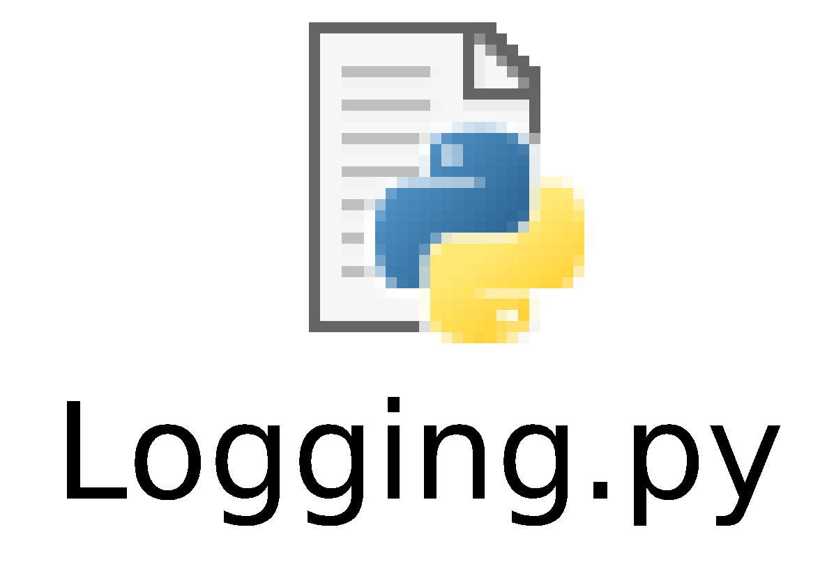
Code with Formatted Log Stamp
When we run the code with the added attribute, we’ll get new lines added to our test.log file
that include the human-readable time stamp in addition to the level name of DEBUG and the associated messages that are passed into the logger as strings.

Slide 8
Output
Output
DEBUG:root:Pizza created: Sicilian ($18)
DEBUG:root:Made 5 Sicilian pizza(s)
DEBUG:root:Ate 4 pizza(s)
DEBUG:root:Pizza created: quattro formaggi ($16)
DEBUG:root:Made 2 quattro formaggi pizza(s)
DEBUG:root:Ate 2 pizza(s)
2017-05-01 16:28:54,593:DEBUG:Pizza created: Sicilian ($18)
2017-05-01 16:28:54,593:DEBUG:Made 5 Sicilian pizza(s)
2017-05-01 16:28:54,593:DEBUG:Ate 4 pizza(s)
2017-05-01 16:28:54,593:DEBUG:Pizza created: quattro formaggi ($16)
2017-05-01 16:28:54,593:DEBUG:Made 2 quattro formaggi pizza(s)
2017-05-01 16:28:54,593:DEBUG:Ate 2 pizza(s)

Slide 9
Table of Logging Levels
As a developer, you can ascribe a level of importance to the event that is captured in the logger by adding a severity level.
The severity levels are shown in the table in next slide.

Slide 10
Table of Logging Levels
Level | Numeric Value | Function | Used to
CRITICAL | 50 | logging.critical() | Show a serious error, the program may be unable to continue running
ERROR | 40 | logging.error() | Show a more serious problem
WARNING | 30 | logging.warning() | Indicate something unexpected happened, or could happen
INFO | 20 | logging.info() | Confirm that things are working as expected
DEBUG | 10 | logging.debug() | Diagnose problems, show detailed information

Slide 11
Default Logging Level
The logging module sets the default level at WARNING
So WARNING, ERROR, and CRITICAL will all be logged by default.
In the example above, we modified the configuration to include the DEBUG level with the following code:
logging.basicConfig(level=logging.DEBUG)

Slide 12
Thanks

